Slide 1
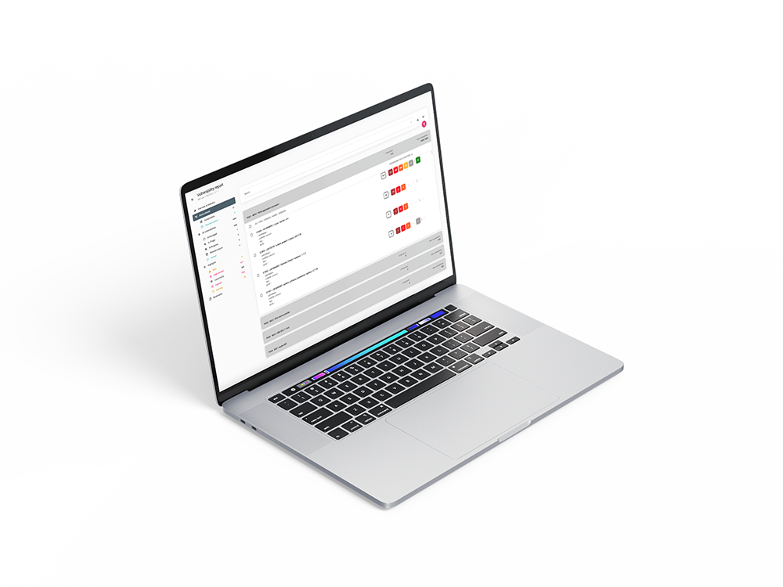

Get grip on product security with ARIANNA
HBOM & SBOM creation | Vulnerability monitoring | Vulnerability management
ARIANNA is a product by

Slide 2
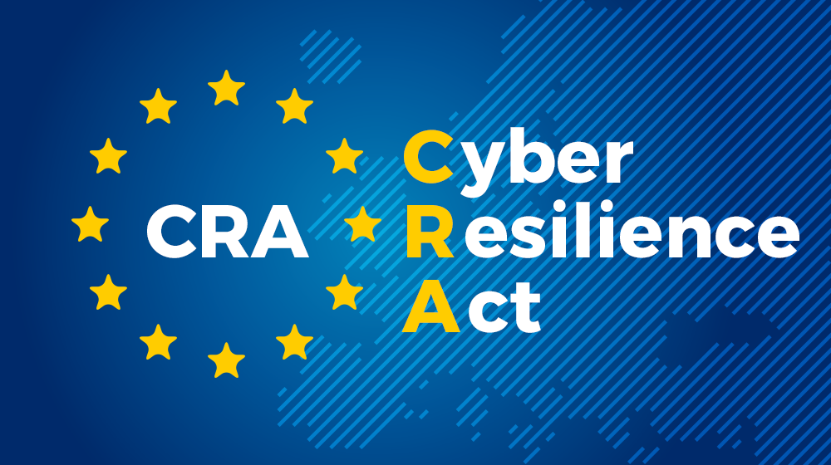
Why Manufacturers Struggle with CRA
CRA requires continuous vulnerability management across the full product lifecycle.
Manufacturers must maintain SBOMs, monitor vulnerabilities, assess risk, and address findings.
Many organizations have some of the building blocks, but not an operational process that scales.

Slide 3
Why ARIANNA exists
Connected products combine hardware and software and often remain in the field for years.
Manual vulnerability tracking does not scale in that environment.
ARIANNA brings HBOM + SBOM visibility, monitoring, prioritization, and reporting into one platform.

Slide 4
From 2,775 Vulnerabilities to 10 Actions
A connected device can contain thousands of known vulnerabilities.
CVSS-only prioritization can leave teams with hundreds of issues to review.
ARIANNA prioritizes based on exploitability and device context, reducing the focus to the vulnerabilities that matter most.
CVSS measures severity. ARIANNA prioritizes risk.
Notes:
CVSS tells us:
"How bad could this vulnerability be?"
It does not tell us:
"How bad is it for my device?"

Slide 5
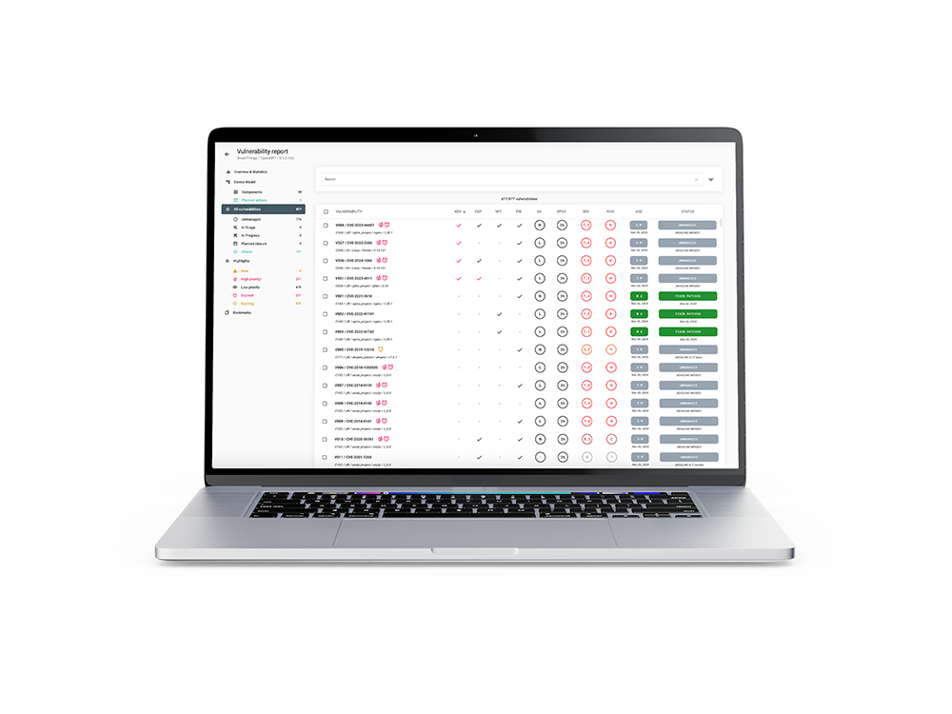
How ARIANNA operationalizes product security
ARIANNA helps device manufacturers run an efficient vulnerability management process.
Build and maintain the device model (HBOM + SBOM)
Continuously monitor new vulnerabilities
Prioritize based on real exploitability and device context
Export reports for customers, internal teams, and regulators

Slide 6
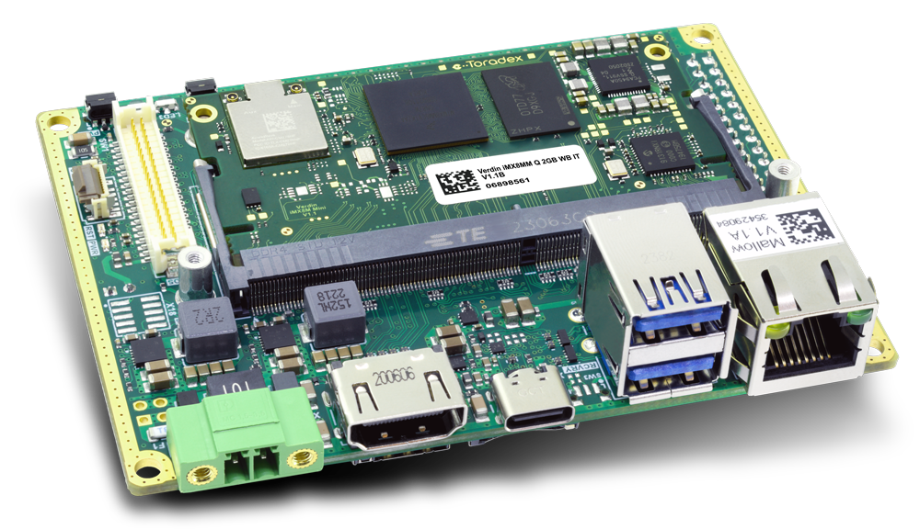
Smart devices are not just software
Hardware Components
MCUs | MPUs | Memories
WiFi, BLE, radio modules | Secure Elements | TPM
Vulnerability management for devices is incomplete without the hardware model.
Hardware components manage critical assets.
Hardware components have vulnerabilities.
They are not exposed to attackers in the same way as software.
The hardware model helps exclude non-reachable software vulnerabilities.
WIFI MODULE
MAIN MPU
MEMORY
MCU
Notes:
In traditional IT systems we think mainly about software vulnerabilities. But smart connected devices are different. They include multiple hardware components, secure elements, and third-party modules. Some vulnerabilities exist in hardware, and many critical assets are managed directly by hardware components. So without a model that includes hardware, vulnerability management for devices is incomplete.

Slide 7
Device Model creation: HBOM
The user identifies the main hardware building blocks of the device.
Each hardware building block is modeled as a Processing Unit (PU).
Examples include MCUs, MPUs, Secure Elements, memories, and WiFi/BLE modules.
For each PU, ARIANNA derives the HBOM from the validated hardware part number.
PU3|ESP32
PU1 | i.MX 93
PU4 | MEMORY
PU2 | STM32F4

Slide 8
Device Model creation: SBOM
For each Processing Unit (PU), ARIANNA supports the creation of the SBOM.
A PU SBOM can combine multiple SBOMs from different software layers.
For MPUs this can include the OS plus customer applications.
For MCUs this can include the bootloader plus application firmware.
The final device SBOM preserves that structure for clearer vulnerability analysis.
Javascript Application
SBOM
Python Application
SBOM
YOCTO SBOM
Bootloader SBOM
Firmware SBOM
Firmware SBOM
PU1 | i.MX 93
PU2 | STM32F4
PU3 | ESP32

Slide 9
Device Model lifecycle & VMP
The device model evolves over the product lifecycle.
HBOM usually remains stable, while SBOM changes with new software and firmware releases.
Each new model version can introduce new vulnerabilities and automatically close others when affected components are updated or removed.

Slide 10
Continuous Vulnerability Monitoring
ARIANNA identifies new vulnerabilities daily for every monitored device based on its device model.
It uses an internal mapping between hardware/software components and known vulnerabilities.
Public sources such as NVD, CVE.org, GitHub Advisories, and EUVD are monitored continuously.
Findings are enriched with KEV status, EPSS, exploit maturity, and CWE information to support better prioritization.

Slide 11
Severity alone is no longer enough
CVSS is useful, but severity alone is not enough for prioritization.
Context matters: a vulnerability in a non-exposed component is very different from the same vulnerability in an internet-facing device.
Exploitability matters more than quantity.
Fixing 5 realistically exploitable vulnerabilities usually improves security more than fixing 50 theoretical ones.
Notes:
Today most vulnerability management processes are based mainly on severity scores like CVSS. And CVSS is absolutely useful — it gives us a standard way to measure how dangerous a vulnerability could be.
The problem is that severity does not tell us how dangerous a vulnerability is for our specific device.
We are measuring vulnerabilities correctly, but we are prioritizing them incorrectly.
Smart connected devices have different risks than IT systems
Most scoring systems were created for IT environments. But smart connected devices have firmware, hardware dependencies, and very different attack surfaces.

Slide 12
Configurable pre-triage engine
ARIANNA includes a configurable pre-triage engine.
It separates identified vulnerabilities into two classes:
High Priority: immediate triage required
Low Priority: risk accepted for later review
This reduces triage effort while keeping final decisions in human hands.

Slide 13
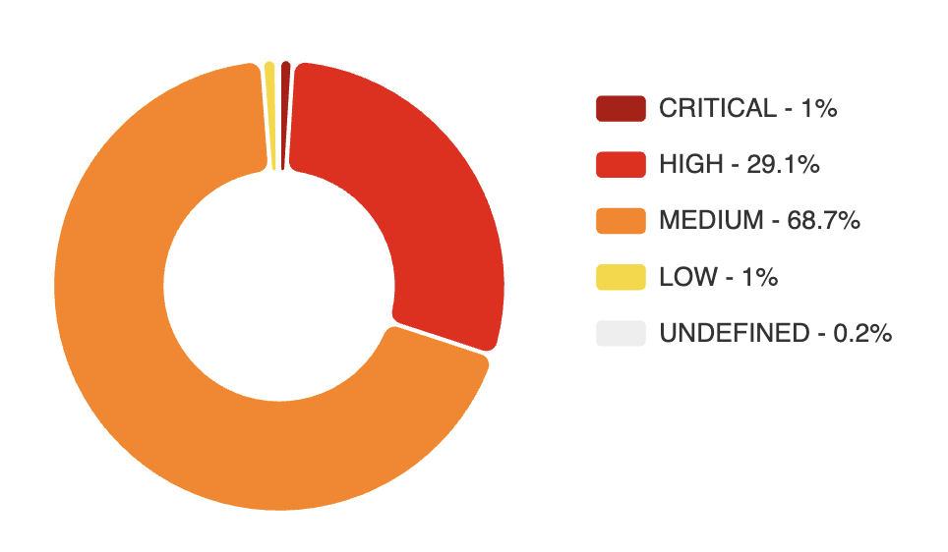
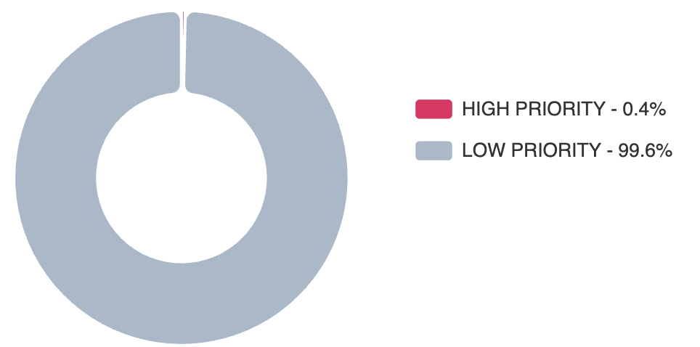
YOCTO Connected Device
2775 identified vulnerabilities
Prioritization based on Severity
CVSS Score > 7.0 (Critical & High)
834 vulnerabilities to triage ASAP (1% + 29.1%)
Prioritization based on Exploitability
Proof of Exploitation or Weaponized exploit
Attack Vector reachable by an attacker
10 vulnerabilities to triage ASAP (0.4%)
Notes:
Left side:
200 vulnerabilities panic random fixing delayed release
Right side:
Context analysis real risk identified focused remediation faster certification

Slide 14
ARIANNA KEV catalogue
ARIANNA KEV focuses on vulnerabilities with evidence of real exploitation.
It includes CISA KEV entries.
It also adds proof-of-exploitation signals from EUVD and verified or weaponized exploits detected by ARIANNA.
This gives broader and faster coverage than relying on CISA KEV alone.
Result: faster prioritization and faster remediation.

Slide 15
Reports for customers & regulatory bodies
Export SBOM and HBOM in standard formats such as CycloneDX and SPDX.
Support NTIA minimum requirements.
Exclude selected components when needed.
Export vulnerability reports on demand in PDF or VEX format.
Generate automatic monthly PDF reports with a full audit trail of actions and status changes.

Slide 16


Collaboration among teams in ARIANNA
Different teams can manage their own projects in ARIANNA while sharing visibility where needed.
A system-level team can reuse vulnerability decisions already made by component teams.
That reduces duplicate triage effort and improves consistency across products and organizations.
VULNs
STATUS
PROJECT A
SBOM & HBOM
TEAM A
VULNs
STATUS
PROJECT B
SBOM & HBOM
TEAM B

Slide 17
What the demo will show
One connected device with 3 processing units:
PU1: i.MX93 MPU with Yocto + JavaScript + Python applications
PU2: STM32F4 MCU with bootloader + application firmware
PU3: ESP32 MCU with application firmware
Two model versions: initial model and an updated ESP32 firmware version
We will show:
The delta between model versions
New and automatically closed vulnerabilities
The high-priority vulnerability view
The exported final report
PU3|ESP32
PU1 | i.MX 93
PU2 | STM32F4

Slide 18
Thank you

